Slide 1
CS4770 – Lecture 6 Authentication
By Chad Mourning
Heavily from the Textbook

Slide 2
What is authentication?
Being able to prove you are who you say you are.
Relies on some secret only you know.
As well as other properties about information.

Slide 3
Can we use symmetric encryption for authentication?
Sort of?
Yes, if you have a shared secret key, you can prove you who you are by sending some message authentication code (do not confuse this with a MAC address) encrypted which is decrypted to prove identity.
Sequence numbers may present a challenge
Important for TCP
This is not a networking class
Usually, TCP packets are bigger than blocks, so sequence numbers may not be in each block
This leads to a vulnerability to block reordering attacks
Blocks will still be “authenticated” but may be out of order

Slide 4
Other properties?
You may also want to authenticate:
Time something was sent
Contents of what was sent
More on this soon

Slide 5
Orthogonality
Some situations where authentication may be appropriate, but confidentiality may not.
Alarms
As long as it’s from the right person, who cares who knows.
Resources constrained devices like embedded systems
Decryption isn’t free, if the data in sensitive, maybe you can skip it.
Authentication itself
Maybe you don’t care if people know that you are the one sending it

Slide 6
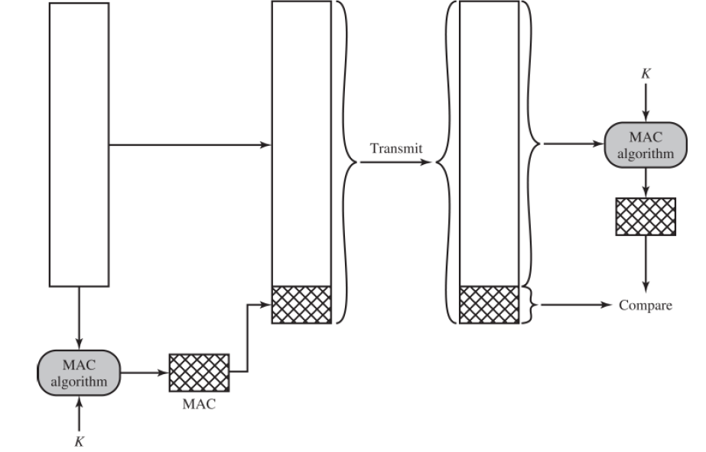
Authenticating Contents?
Need a way to ensure:
If the message is altered the authenticated MAC is different.
Sender is verified (by secret key)
Solves block reordering.

Slide 7
Solutions
DES (originally recommended in FIPS 113 from 1985)
Since withdrawn.
AES
One Way Hashes
All you need to do verify the results are the same, you already have the contents.
Low collision rate required.
Doesn’t even need a secret key.

Slide 8
Hashes!
We talked about md5 before.
Fun demo of SHA256:
https://mybinder.org/v2/gh/ODHE-OHIO/jupyter-public/HEAD
More about SHA
SHA-1 introduced by NIST FIPS 180 in 1993.
Oops, NIST FIPS 180-1 in 1995 fixed some bugs.
SHA-1 was 160 bits
SHA-2 is a collection of SHA-256, 384, and 512 bit versions.
More detail here: https://en.wikipedia.org/wiki/SHA-2

Slide 9
Properties of a good hash
H can be applied to a block of data any size
This frequently ends up breaking it into chunks and then combining
By XOR? Because you want a fixed length output.
Should be easy to compute for all values
Because maybe you want to build an ASIC from it.
Should be computationally infeasible to find x from H(x)
This is what makes it one way or first preimage resistant.
Travelling Salesman anecdote.
“Individual science fiction stories may seem as trivial as ever to the blinder critics and philosophers of today, but the core of science fiction -- its essence -- has become crucial to our salvation, if we are to be saved at all.”
Should be computationally infeasible to find H(x) == H(y) where x != y.
Weak collision avoidance.
Second preimage resistant.
Maybe a preimage attack assignment in the future?
Should be computationally infeasible to find x,y where H(x) == H(y)
Strong collision avoidance.
Would allow sending alternative messages that are deemed “authentic”.

Slide 10
Other applications?
Passwords also rely on one-way hashes
Doesn’t matter what you type, only that when hashed it matches the has
This keeps anyone from every needing to see your actual password.
If a Sysadmin can tell you what your current password is, run.

